Slide 1
Gist
Finalizing the simulations | Done
Using Biorbd to calculate finger velocity in phase 1 for the selected animations | Done
Addressing terms of the dynamic equation in phase 2 | Done

Slide 2
General Overview:
The piano is positioned 12.4 cm vertically from the origin of the pelvis. This aligns with the experimental datasets. The pelvis segment has a length of 17 cm, with its center of mass (COM) located 8 cm from the origin. The horizontal distance between the pelvis and the piano is 51 cm.
The objective functions are set to minimize all degrees of freedom (DOFs), except for the wrist and finger, with a weight of 0.001. For the wrist and finger, the weight is set to 200. In phases 0 and 1, the objective is to minimize the angular velocity (qdot) of the wrist, with a weight of 0.2.
I have completed the changes to the code as per our discussion. You can review the commit on GitHub also as well:
https://github.com/Alpha2Shahiri/PianOptim/commits/Under_Dev_Nov/

Slide 3
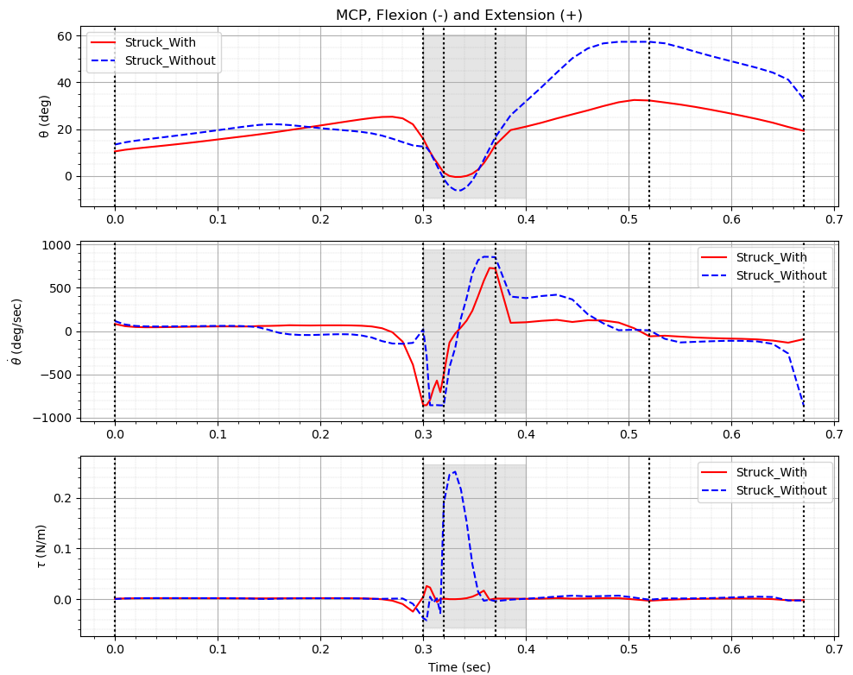
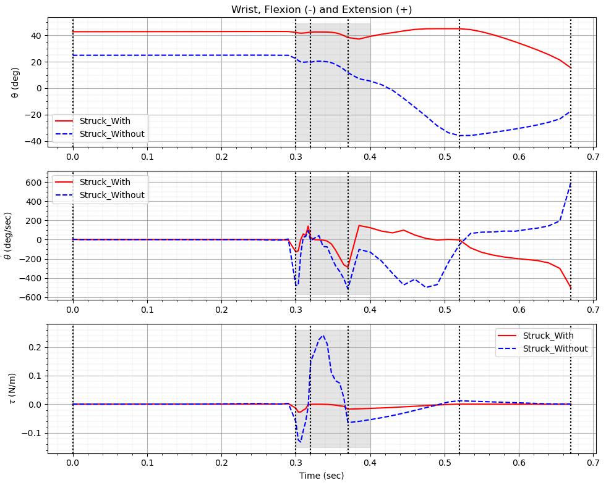
Result for Struck Touch

Slide 4
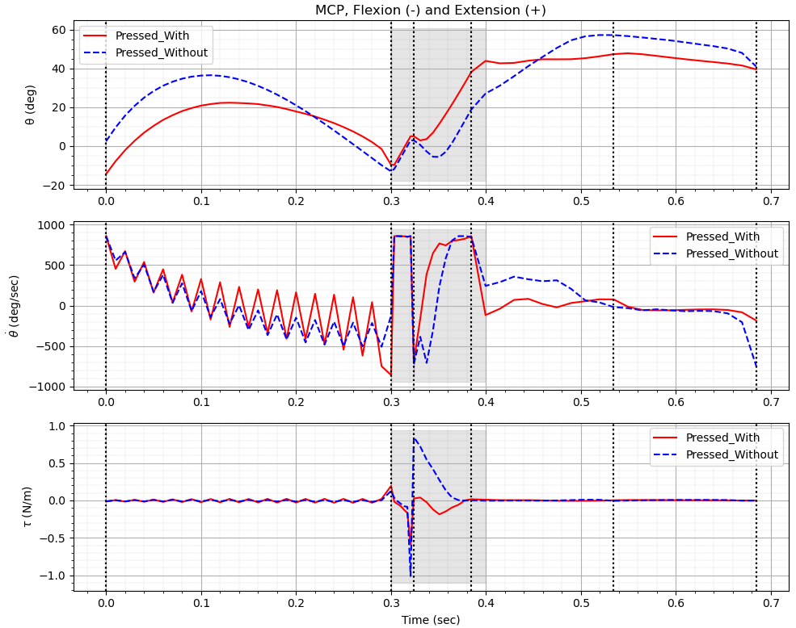
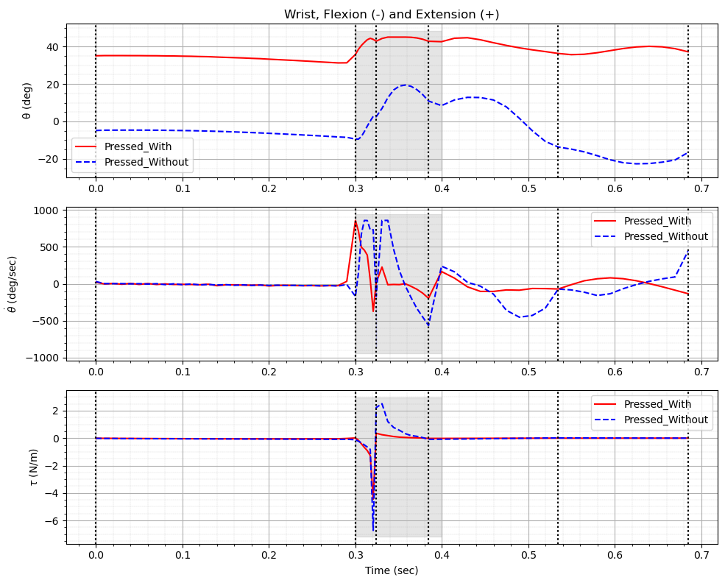
Result for Pressed Touch

Slide 5
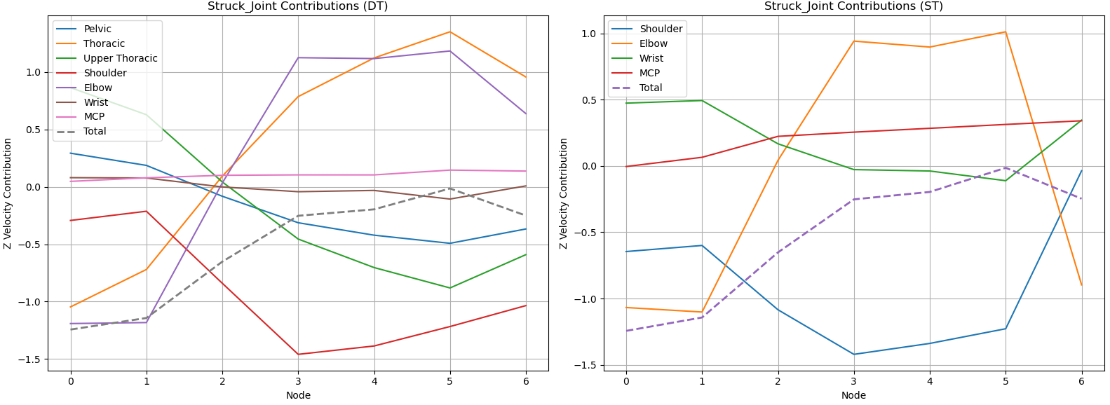
Finger velocity in phase 1_Result for Struck Touch

Slide 6
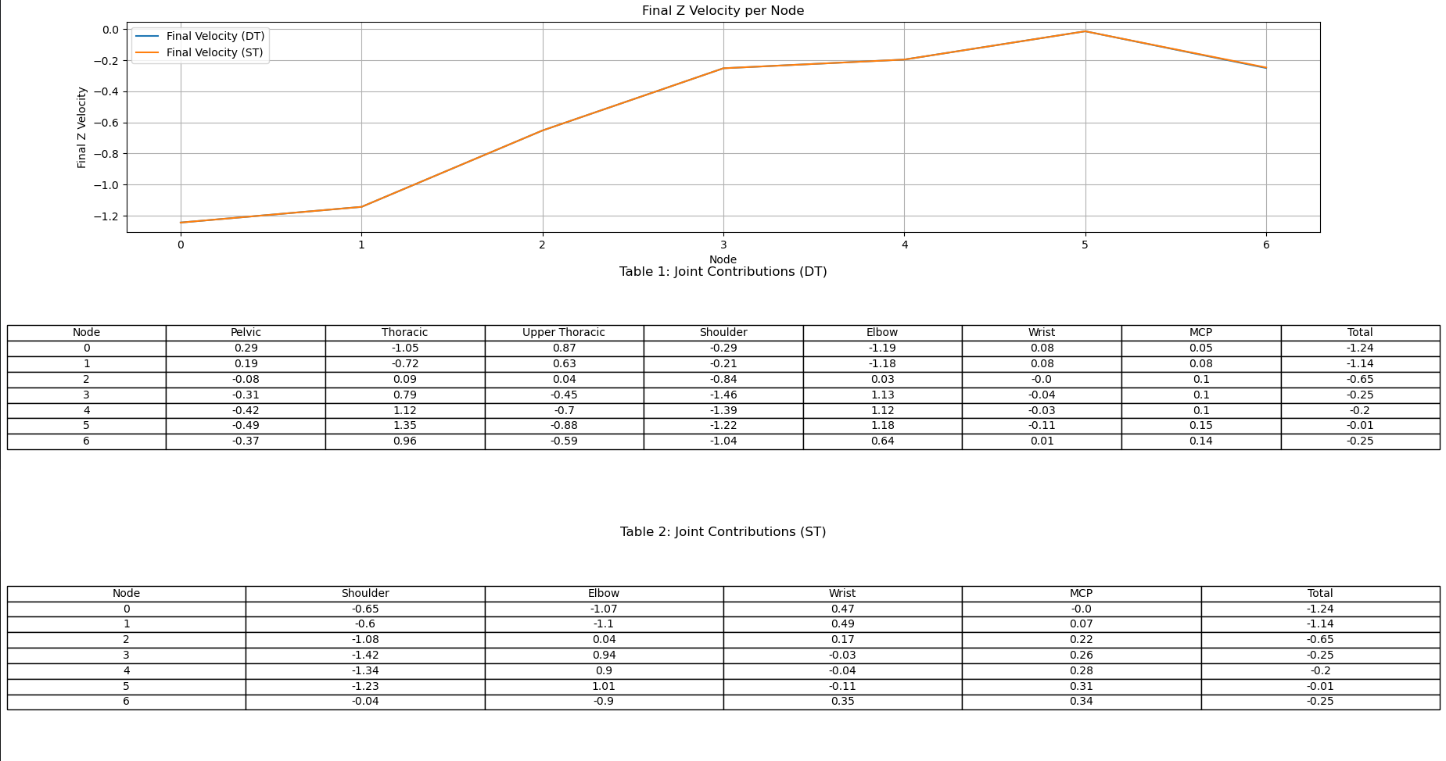
Finger velocity in phase 1_Result for Struck Touch (Additional Info)

Slide 7
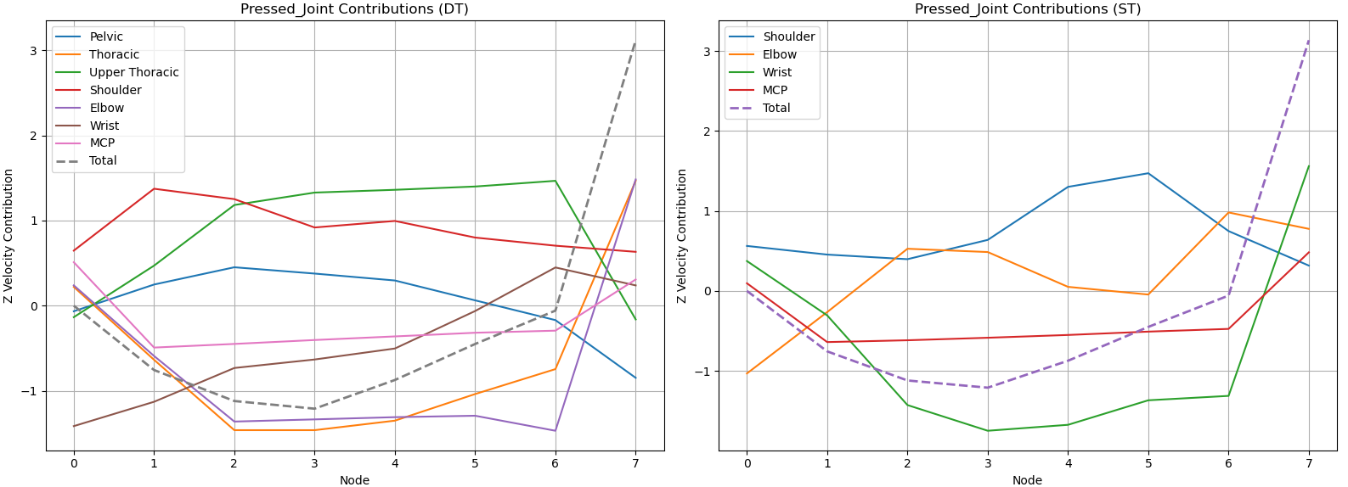
Finger velocity in phase 1_Result for Pressed Touch

Slide 8
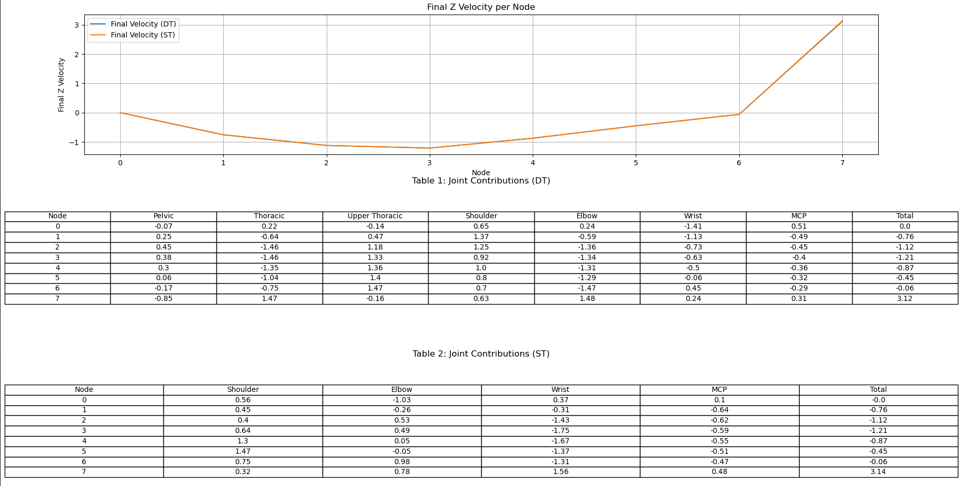
Finger velocity in phase 1_Result for Pressed Touch (Additional Info)

Slide 9
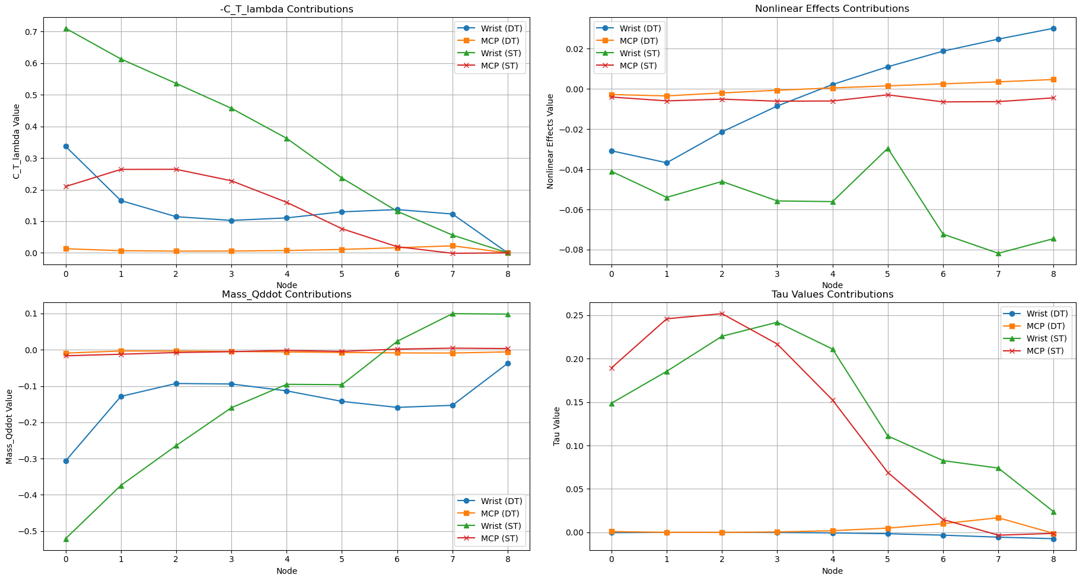
Dynamic Equation Terms in phase 2_Result for Struck Touch

Slide 10
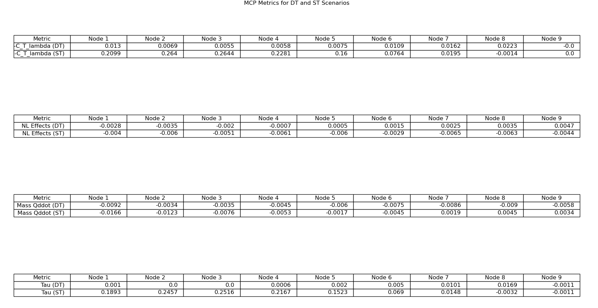
Dynamic Equation Terms in phase 2_Result for Struck Touch (Additional Info)

Slide 11
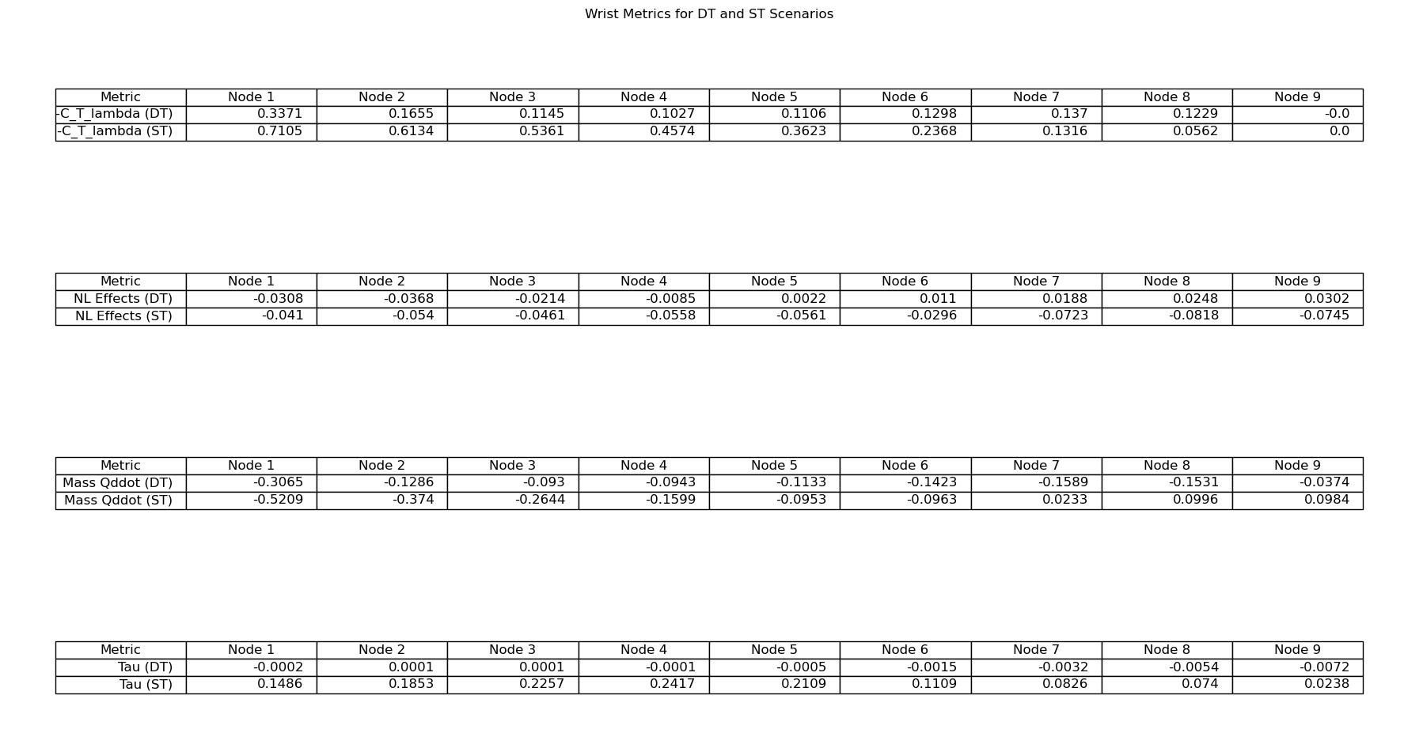
Dynamic Equation Terms in phase 2_Result for Struck Touch (Additional Info)

Slide 12
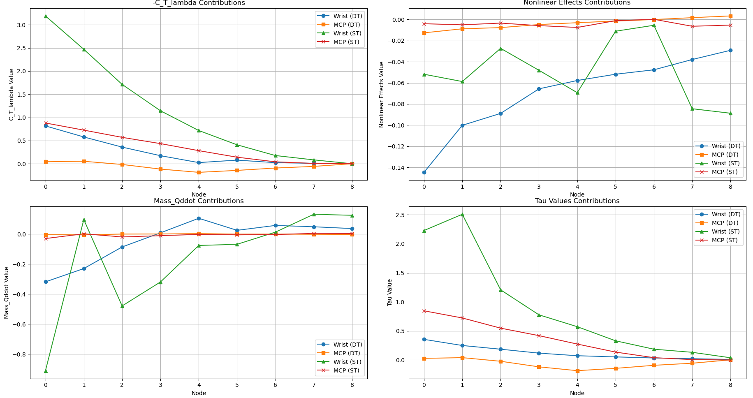
Dynamic Equation Terms in phase 2_Result for Pressed Touch

Slide 13
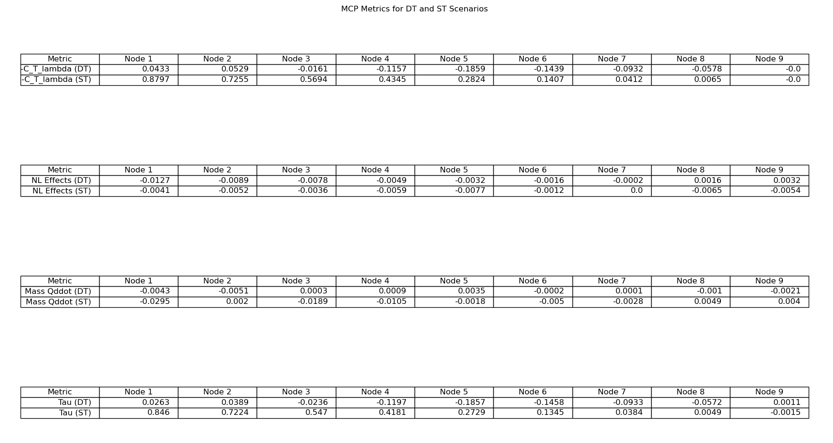
Dynamic Equation Terms in phase 2_Result for Pressed Touch (Additional Info)

Slide 14
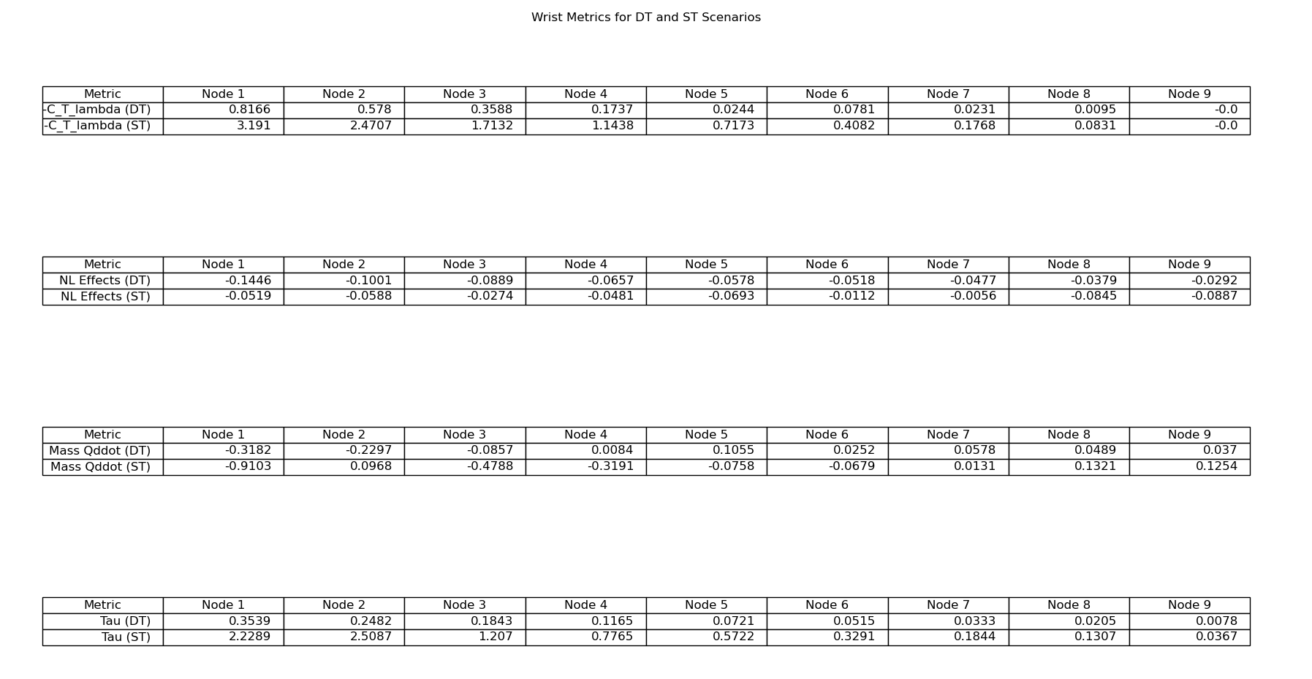
Dynamic Equation Terms in phase 2_Result for Pressed Touch (Additional Info)

Slide 15
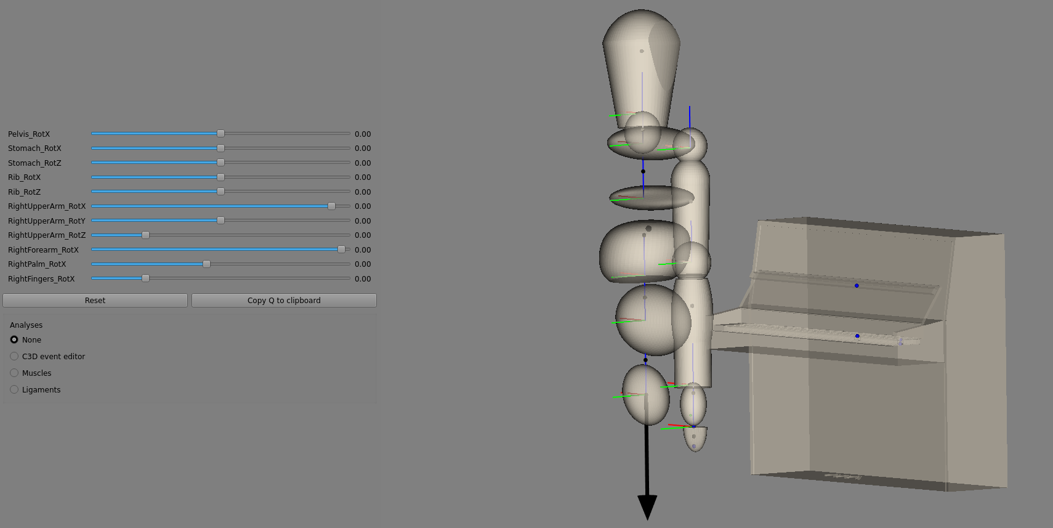
Review: Joint indices in the biomechanical model
Skip if you don't have time
#0. Pelvic Tilt: Anterior (+) Tilt / Posterior (-) Tilt
#1. Thoracic Flexion/Extension: Flexion (+) / Extension (-)
#2. Thoracic Rotation: Left (+) / Right (-)
#3. Upper Thoracic (Rib Cage) Flexion/Extension: Flexion (+) / Extension (-)
#4. Upper Thoracic (Rib Cage) Rotation: Left (+) / Right (-)
#5|0 Shoulder Flexion/Extension: Flexion (-) / Extension (+)
#6|1 Shoulder Abduction/Adduction: Abduction (+) / Adduction (-)
#7|2 Shoulder Internal/External Rotation: Internal (+) / External (-)
#8|3 Elbow Flexion/Extension: Flexion (-) / Extension (+)
#9|4 Forearm Pronation/Supination: Pronation (Left +) / Supination (Right -)
#10|5 Wrist Flexion/Extension: Flexion (-) / Extension (+)
#11|6 Metacarpophalangeal (MCP) Flexion/Extension: Flexion (-) / Extension (+)
3
2
2
2
1
1
1

